Slide 2
TEKNOFLOR and ASPECTA

Slide 3
WHO WE ARE…
HMTX Commercial holds both the Teknoflor and Aspecta brands. As a major manufacturer and distributor our core focus is developing high-performance and high-design flooring products. To date, all of our products offer no-wax, no-buff flooring solutions that provide a strong ROI for our clients in the Education, Healthcare, Hospitality, Government, Corporate, and Retail markets.
Keeping the needs of our clients at the forefront of our manufacturing process, we combine quality, durability and state-of-the-art technology, in resilient flooring and offer heterogeneous and homogeneous sheet vinyl, tiles and planks, that are 100% virgin vinyl, phthalate free or bio based.

Slide 4
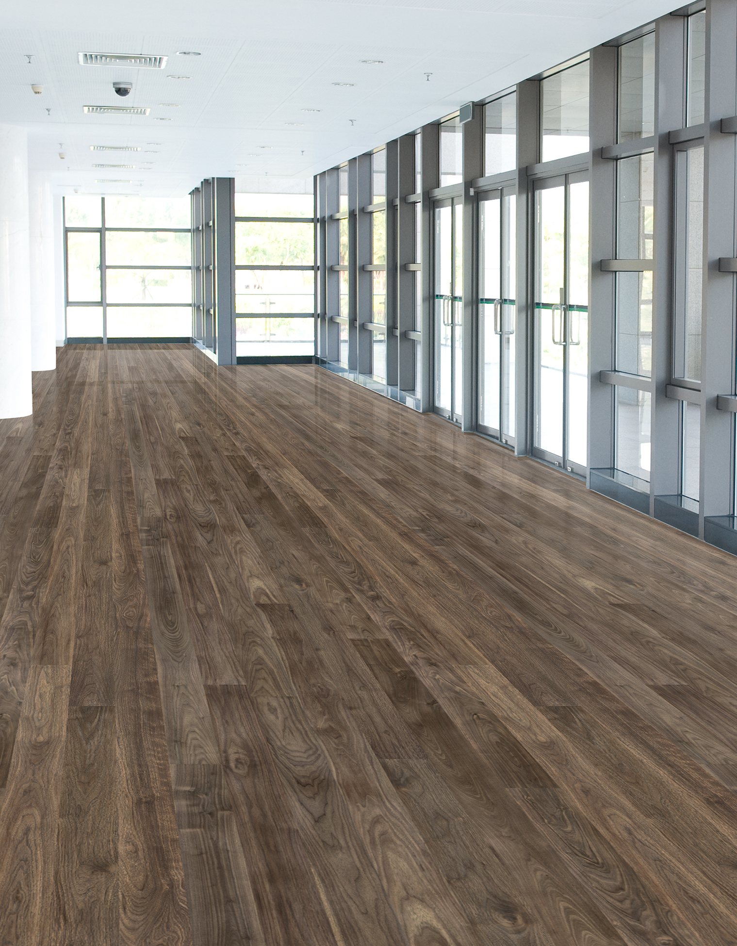
HIGH PERFORMANCE DESIGN
Over the past seven years, our Teknoflor brand has not only improved the composition of its products, removed phthalate plasticizers and opted for 100% virgin vinyl construction, but it has also improved the durability and performance.
These second-generation products are marked with HPD, signifying High Performance Design and rate the highest in the industry in Chemical Resistance, Coefficient of Friction and Chair Castor ratings.

Slide 5
RESILIENT SHEET
Teknoflor has long-stood as the leader in the resilient sheet market, focusing on high-performance, low-maintenance, beautiful flooring. Our success has fostered our focus on durability, cleanability and safety throughout our resilient line.
Our seamless flooring solutions offer beautiful aesthetics, in over 100 skus, with unmatched durability and now is enhanced with coordinating tiles and planks. The available design options are only limited by the imagination.

Slide 6
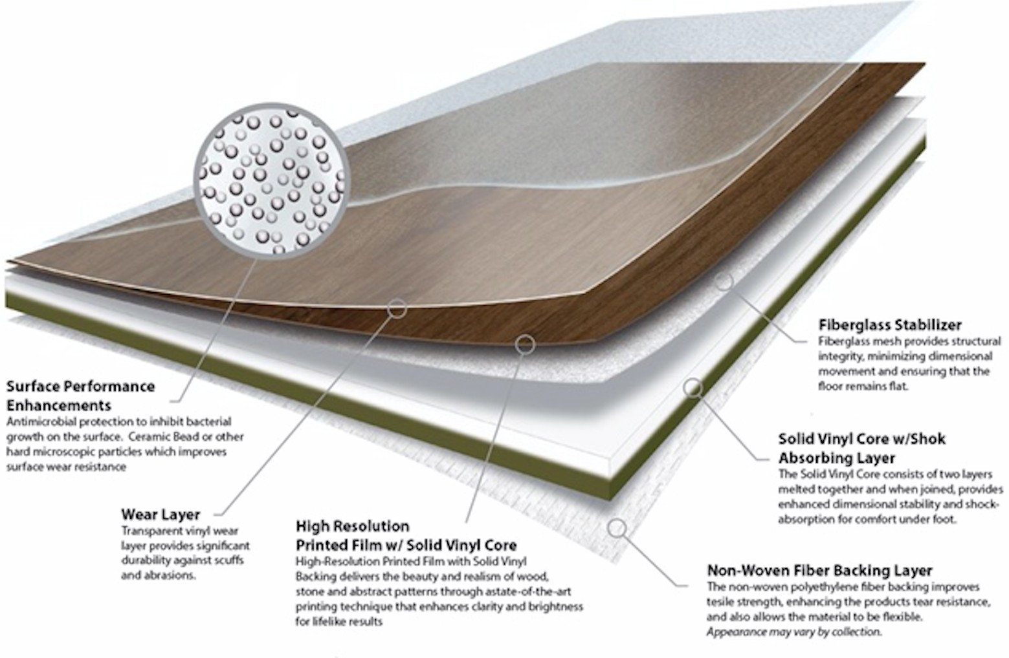
CONSTRUCTION

Slide 7
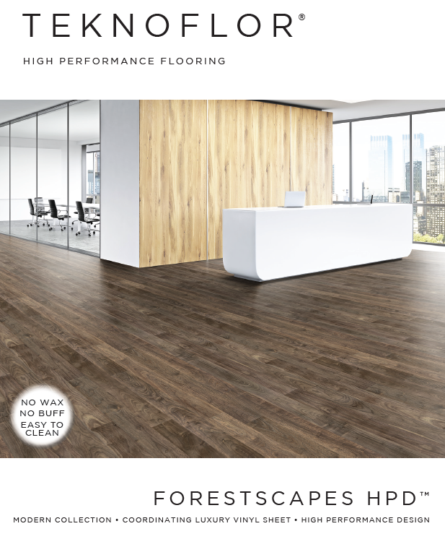
FORESTSCAPES HPD
Modern wood visual
Coordinates with Forest Plank in size and color
100% Virgin Vinyl
Phthalate Free
High Performance Design
High Chemical Resistance
12 Year Non-Prorated Warranty
Reach, FloorScore Certification, Health Product Declaration
No Wax, No Buff
Versatile color palette

Slide 8
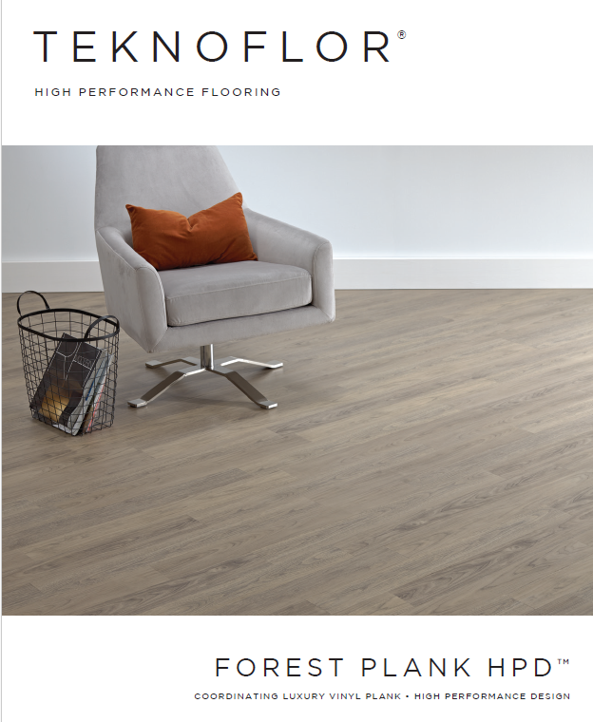
FOREST PLANK HPD
Modern wood visual 4”w x 36”l plank
Coordinates with Forestscapes HPD
100% Virgin Vinyl
Phthalate Free
High Performance Design
High Chemical Resistance
12 Year Non-Prorated Warranty
Reach, FloorScore Certification, Health Product Declaration
No Wax, No Buff
Versatile color palette

Slide 9
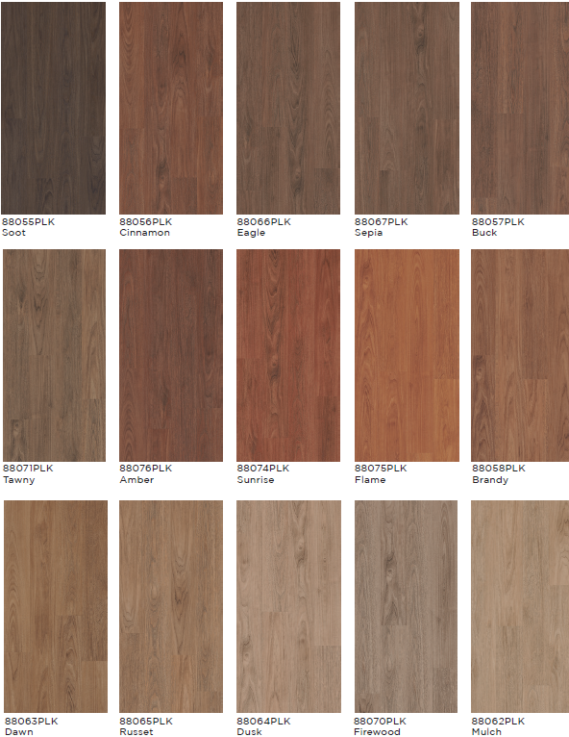
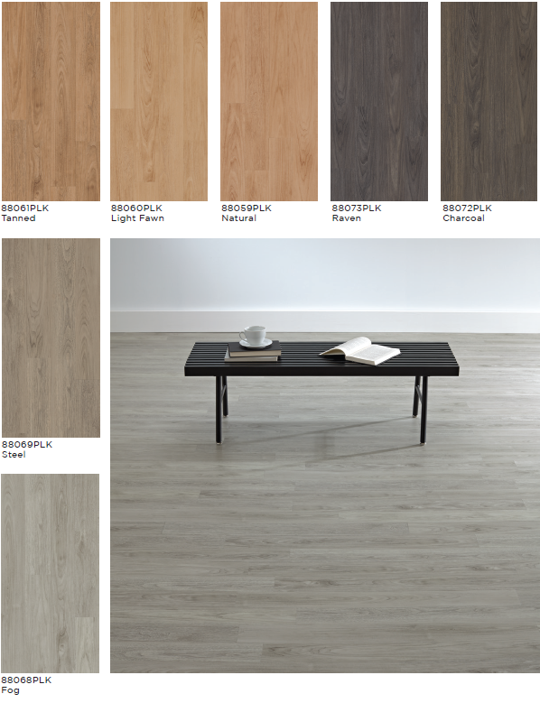
FORESTSCAPES HPD SHEET + PLANK

Slide 10
UNIVERSITY OF ILLINOIS

Slide 11
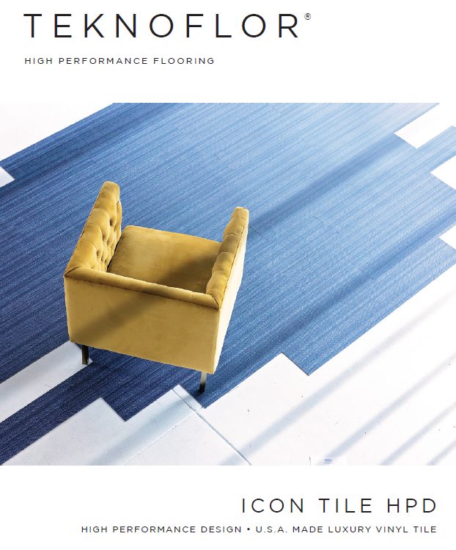
ICON TILE + PLANK
12” x 24” tiles / 7.08”w x 47.24” planks
No Wax, No Buff
2.5 mm gauge for enhanced performance in heavy traffic areas
Complies with REACH requirements for Substances of Very High Concern
No antimicrobial agents added
Made with 100% Virgin Vinyl
FloorScore Certified
ADA Compliant
28 mil wear layer thickness
20-Year non-prorated commercial warranty

Slide 12
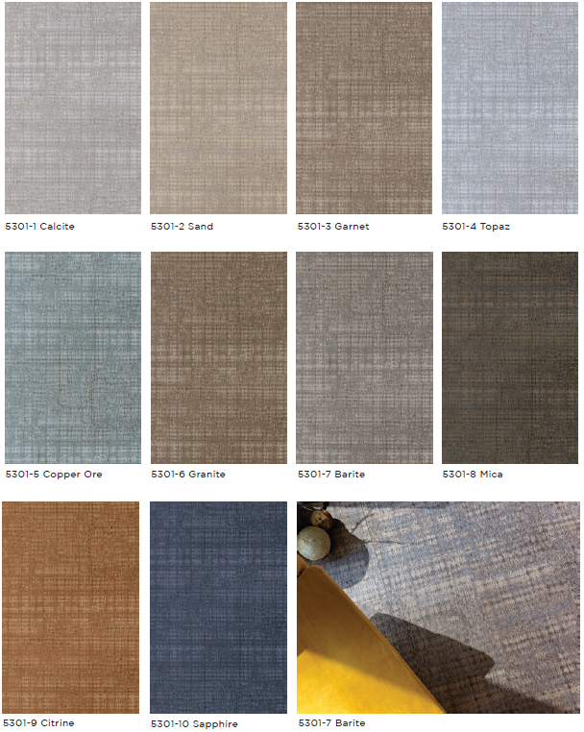
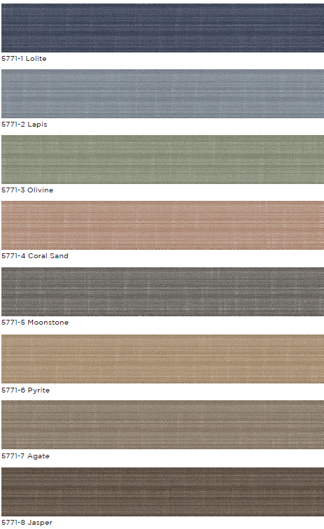
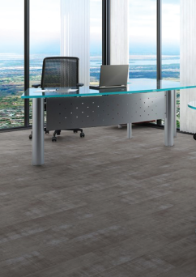
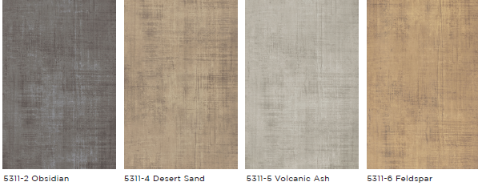

Slide 13
SYMPHONY COLLECTION
24 options in three unique abstract styles – Woodwind / Brass / Strings - to create a harmonious whole
2.3 mm gauge for enhanced performance in high traffic areas
Complies with REACH requirements for Substances of Very High Concern
No antimicrobial agents added
Made with 100% Virgin Vinyl
FloorScore Certified
ADA Compliant
12-Year Limited Commercial Warranty
Winner of NIGHTINGALE AWARDS 2023 Silver Award for Resilient Flooring by HMTX Industries Design Team, presented by Healthcare Design

Slide 14
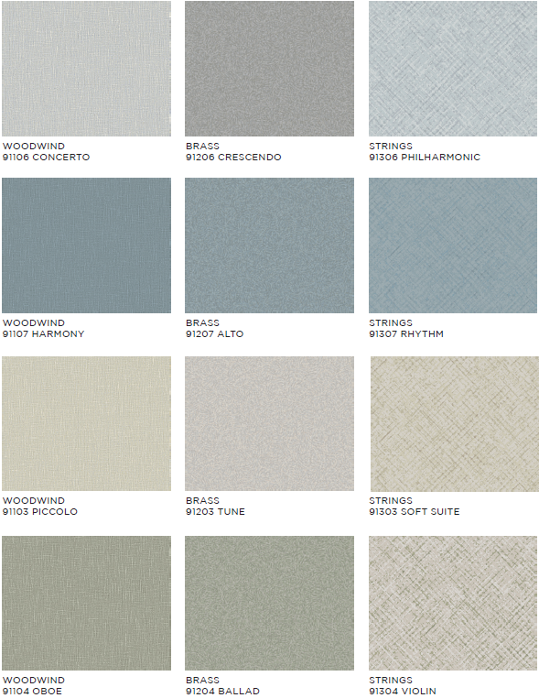
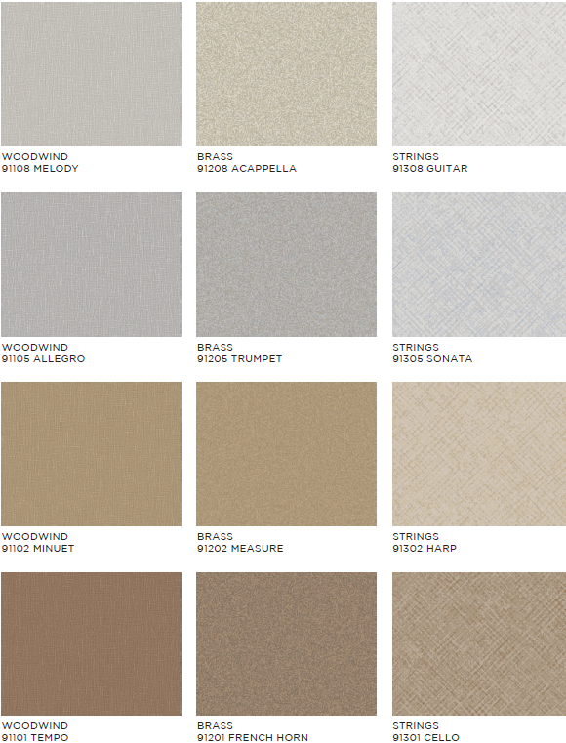

Slide 15
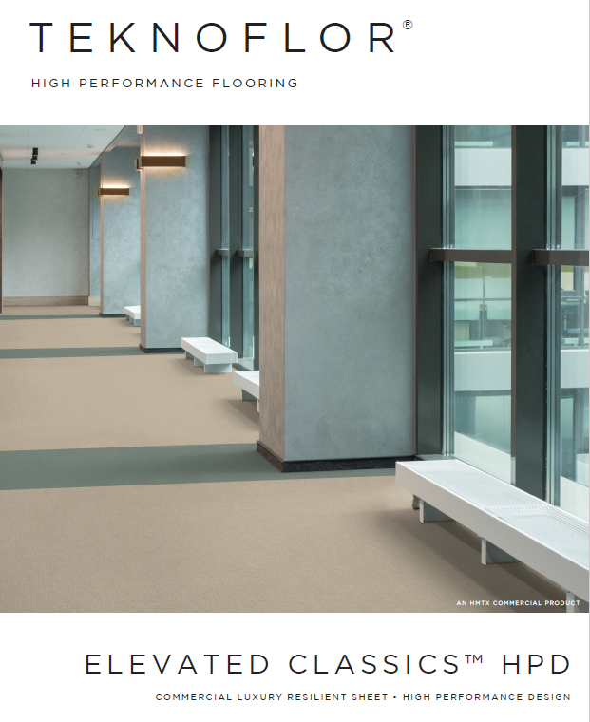
ELEVATED CLASSICS COLLECTION
Offers the timeless beauty of classic textiles with a modern upscale twist
Inspired and engineered to elevate Teknoflor’s favorite visuals
No Wax, No Buff
2.3 mm gauge for enhanced performance in heavy traffic areas
Complies with REACH requirements for Substances of Very High Concern
No antimicrobial agents added
Made with 100% Virgin Vinyl
FloorScore Certified
ADA Compliant
12-Year Limited Commercial Warranty

Slide 16
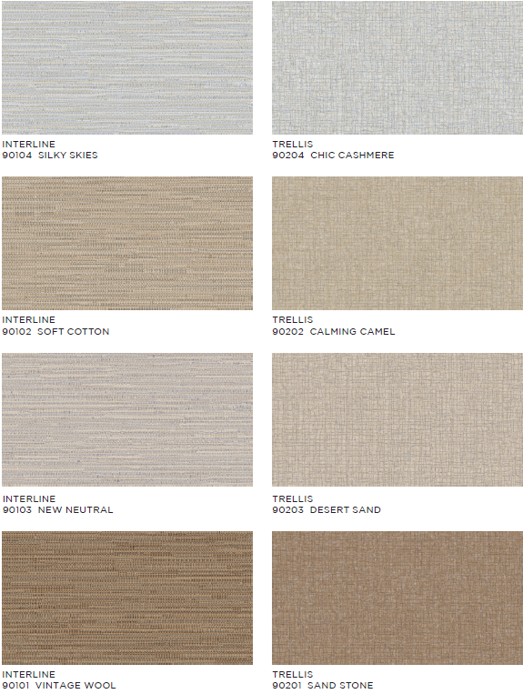
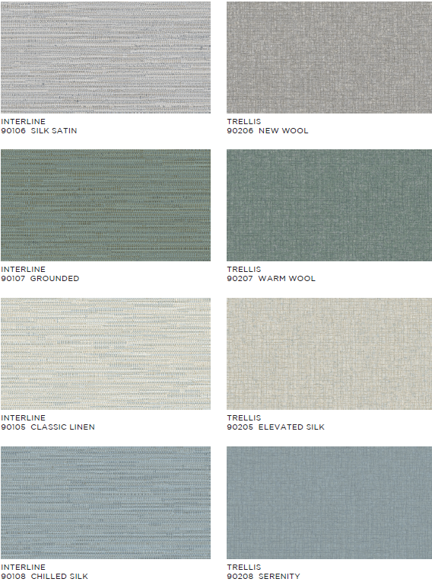

Slide 17
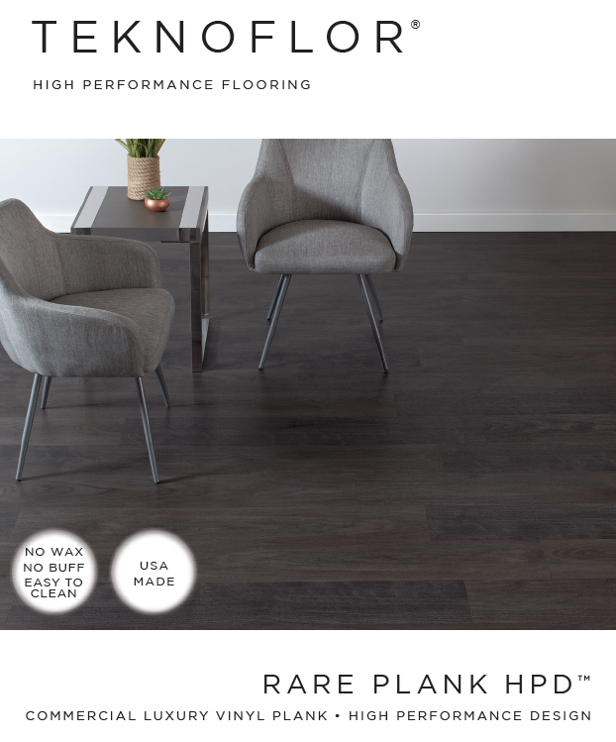
RARE PLANK
No Wax, No Buff
7.09”w x 47.24”l planks
3.0mm gauge for enhanced performance in heavy traffic areas
TekDefend incorporated into the wear layer which effectively inhibits bacterial growth on the flooring surface
Complies with REACH requirements for Substances of Very High Concern
Made with 100% Virgin Vinyl
FloorScore Certified
ADA Compliant
20-Year Limited Commercial Warranty

Slide 18
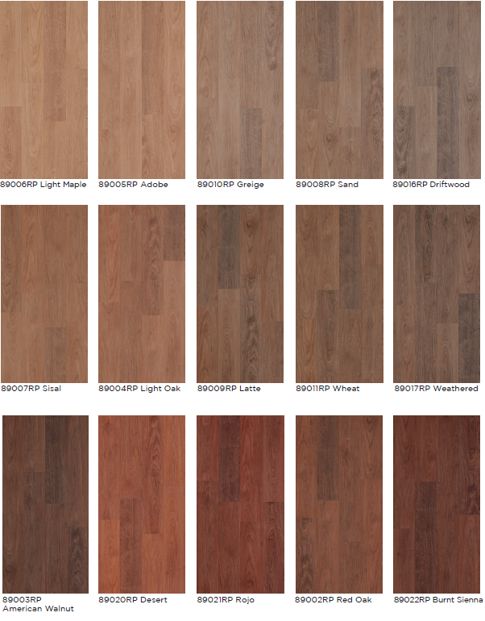
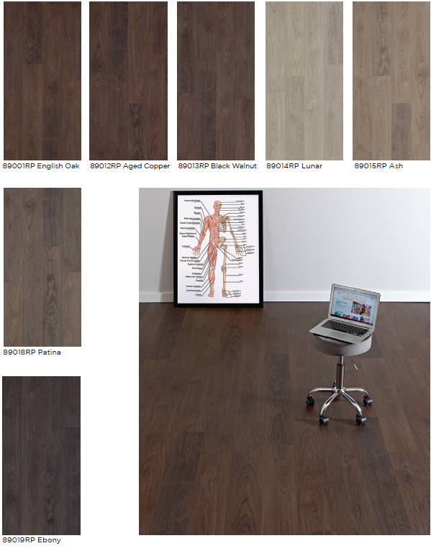

Slide 19
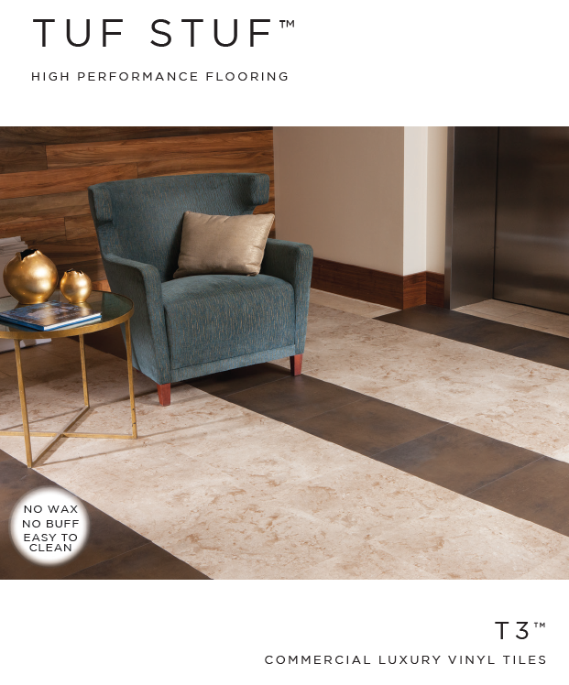
T3
Three Distinct Styles / Textures – Textiles – Technology
18” x 18” and 18” x 36” Tiles
No Wax, No Buff
3mm overall thickness
TekDefend incorporated into the wear layer which effectively inhibits bacterial growth on the flooring surface
ADA Compliant
15-Year Commercial Warranty
Design friendly look with the durability of a hard surface product

Slide 20
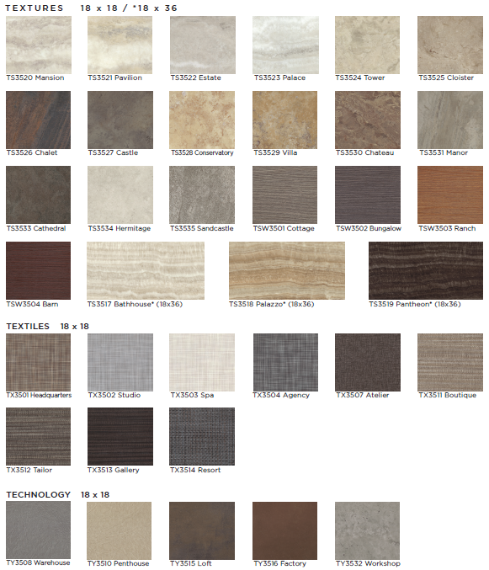

Slide 21
NASHVILLE PUBLIC LIBRARY

Slide 22
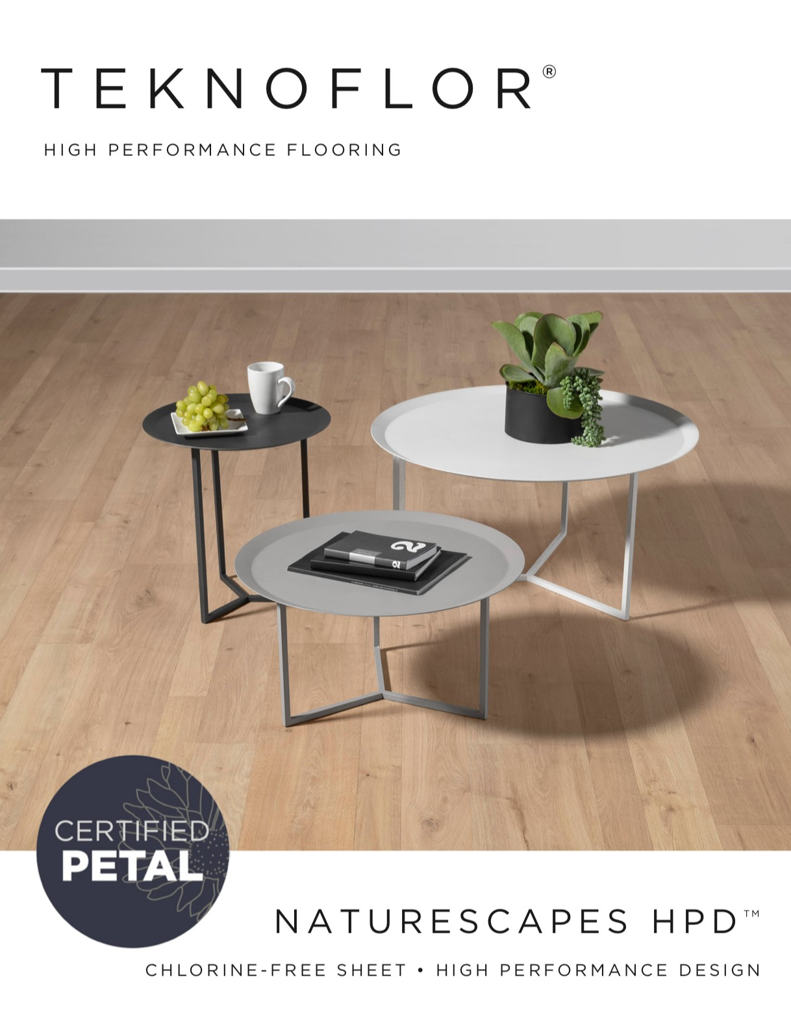
NATURESCAPES + NATURE’S TILE
Available Sheet / Coordinating Tile (24 / 16 visuals)
Competes with Rubber / Linoleum / Sheet Vinyl / LVT
REACH Compliant for Substances of Very High Concern
Can Be Installed Together
Excellent Chemical Resistance
Certified PETAL (Living Product Challenge)
Multiple Market Segments
True NO WAX
12 Year Warranty

Slide 23
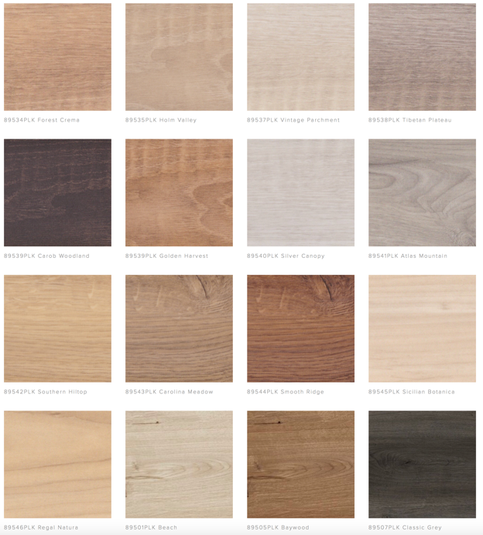
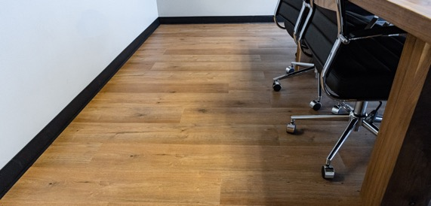

Slide 24
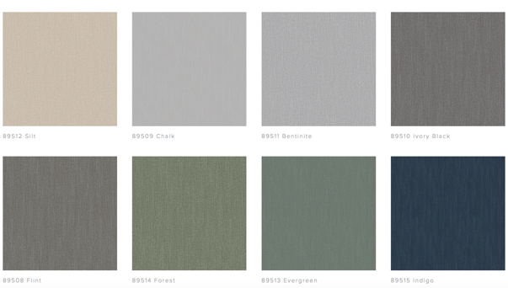
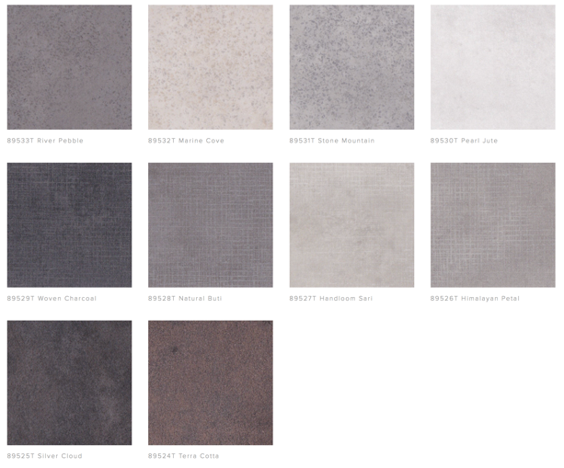
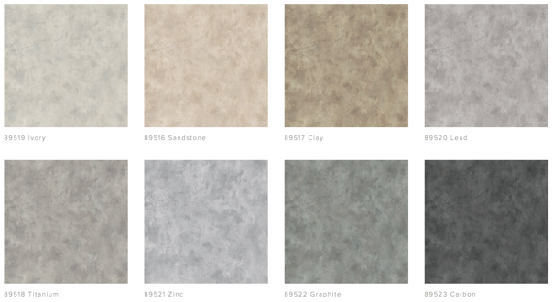

Slide 25
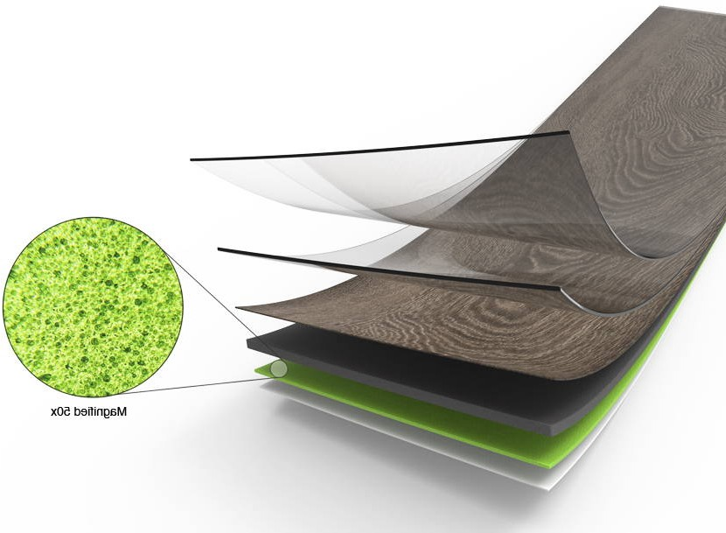
PRIME WITH S E T A G R I P ™
Teknoflor® Prime™, with Setagrip™ technology, brings a new level of versatility and ease of installation to the commercial flooring industry. Using biomimicry, Setagrip technology uses millions of micro-sized pores, which create negative air pressure to securely adhere to a non-porous surface without the need for an adhesive.
Teknoflor Prime HPD is offered in twenty vibrant and neutral hues in a 12” x 24” format and a durable 5mm gauge and tough 30mil wear layer. Perfect for any commercial application, Prime HPD holds true to Teknoflor’s No Wax, No Buff principle and its promise of high-performance design.

Slide 26
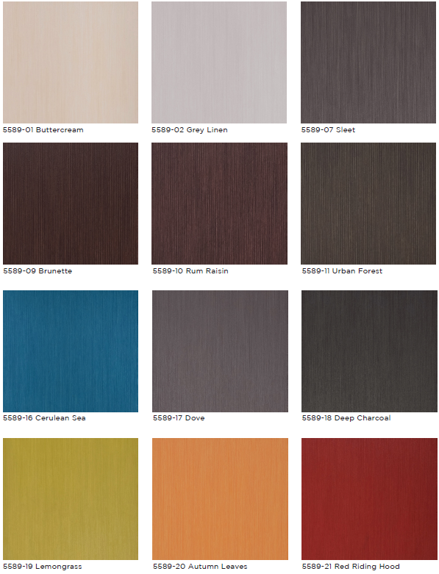
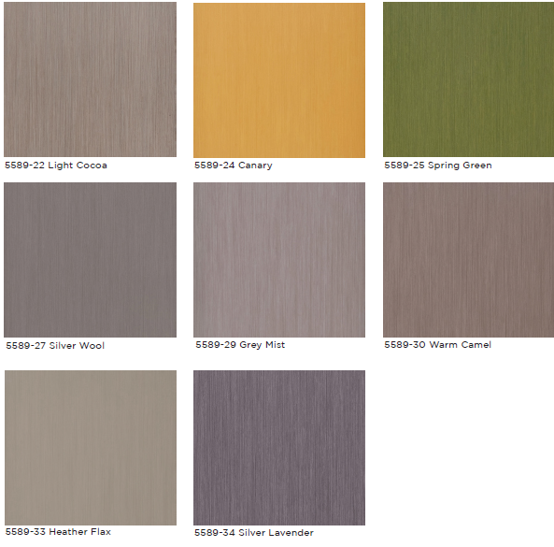
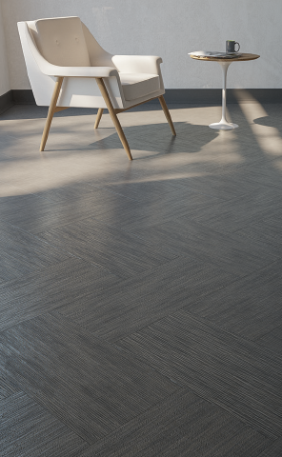

Slide 27
ASPECTA ONE
22 mil wearlayer/2.5mm thick
Unique wood, stone, and abstract visuals
Design flexibility = Option to install Aspecta One and Aspecta One Ornamental together
Urethane coating with ceramic beads provide superior wear, stain resistant and tough, long-lasting wear
Unlimited custom capabilities to include school colors

Slide 28
ASPECTA CONTOURS
2.5 mm thick
Floating click installation = no adhesive, quick installation
Key component is the Isocore technology (closed cell extruded vinyl structural core) = 100% waterproof, strong, rigid, dimensionally stable
Duraspect Extreme Surface protectants = unmatched abrasion resistance and stain repellency for easy care and maintenance
Pre-attached sound mitigating underlayment – provides insulating characteristics and increased sound absorption, minimizes both reflected and transmitted sound
20-year non-prorated warranty

Slide 29
JEFFERSON TECHNICAL COLLEGE

Slide 30
Give us a try…

