Slide 1
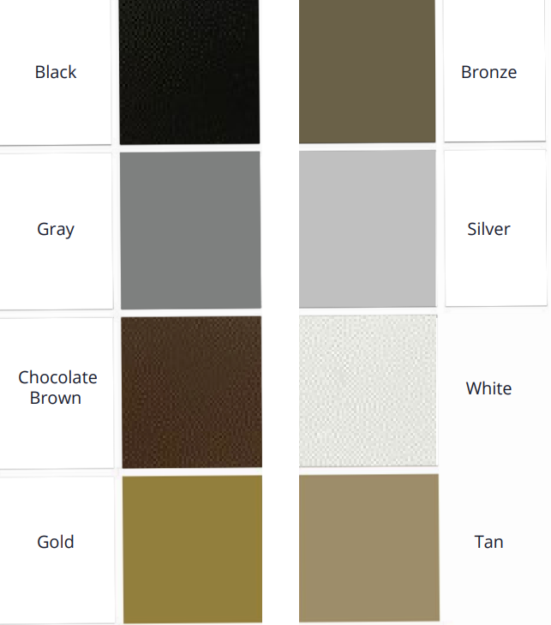
Standards
Maple: 1” thick and 1.25” thick.
Stains:
Aged Ash
Early American
Mocha
Jacobean
Ebony
Base Colors:
All available standards below.

Slide 2
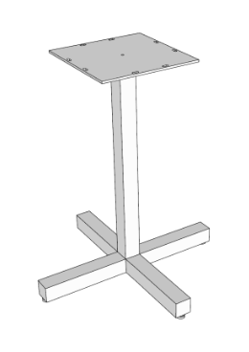
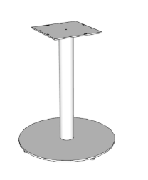
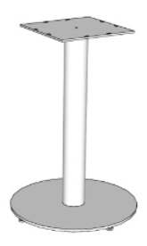
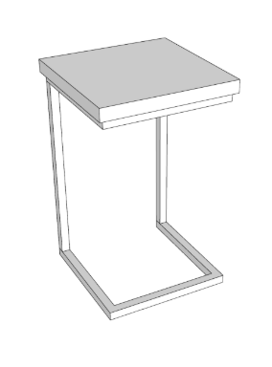
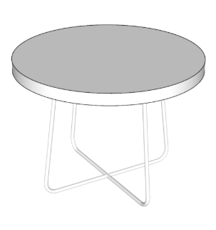
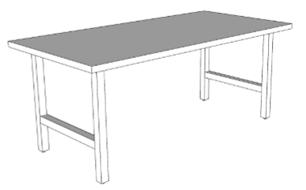
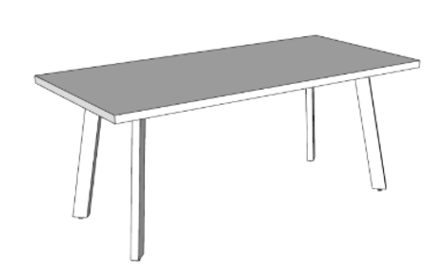
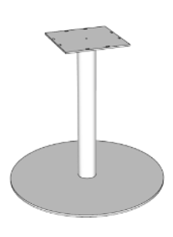
Description | Top Shape | Overall Dimensions | Price | Base Line Drawing
Cafe Table Design A (Pedestal Base, Cross Style, 2”Square Tube w/Levelers) | Square Round | 48”W x 29.5”H x 1.25”TH. 30”W x 29.5”H x 1.25”TH. | Square 48”: $1139 Square 30”: $722 Round 48”: $1139 Round 30”: $722
Café Table Design B (Pedestal Base, 20” Round Disc (30” top), Pedestal Base, 24” Round Disc (48” Top)). | Square Round | 48”W x 29.5”H x 1.25”TH. 30”W x 29.5”H x 1.25”TH. | Square 48”: $1228 Square 30”: $792 Round 48”: $1228 Round 30”: $792
Café Table – BAR HEIGHT (Pedestal Base, 20” Round Disc) | Square Round | 30”W x 41.5”H x 1.25”TH. | Round: $872 Square: $872
End Table – Square (Laptop Table 1” Square Tube) | Square | 18”W x 25.5”H x 1”TH. 16”W x 25.5”H x 1”TH. | Square 18”W: $503 Square 16”W: $437
End table – Round (1/2” Rod Base, Occasional) | Round | 24”W x 17.5”H x 1”TH. 16”W x 17.5”H x 1”TH. | Round 24”W: $454 Round 16”W: $304
Community Table Design A (H-Leg 2” Square Tube) | Rectangle | 36”W x 96”L x 29.5”H x 1.25”TH. 36”W x 76”L x 29.5”H x 1.25”TH. | 96”L: $1613 76”L: $1413
Community Table Design B (Post Leg, 3" x 1.5" Rectangular Tube, angled 10 degrees) | Rectangle | 36”W x 96”L x 29.5”H x 1.25”TH. 36”W x 76”L x 29.5”H x 1.25”TH. | 96”L: $1754 76”L: $1555
Community Table Design C (Pedestal Base, 30" Round Disc) | Round | 54”W x 29.75”H x 1.25”TH. | Round 54”: $1755
Coffee Table Design A (1/2" Rod Base) | Round | 40” W x 17.5”H x 1.25”TH. 32” W x 17.5”H x 1.25”TH. 24” W x 17.5”H x 1”TH. 16” W x 17.5”H x 1”TH. | Round 40”: $782 Round 32”: $623 Round 24”: $454 Round 16”: $304

Slide 3
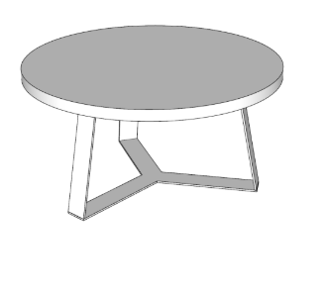
Coffee Table Design B (Y-Base, 3" Flat Stock, angled 10 degrees) | Round | 40” W x 17.5”H x 1.25”TH. 32” W x 17.5”H x 1.25”TH. 24” W x 17.5”H x 1”TH. 16” W x 17.5”H x 1”TH. | Round 40”: $920 Round 32”: $763 Round 24”: $594 Round 16”: $444
Prices good through 12/31/2024.

Slide 4
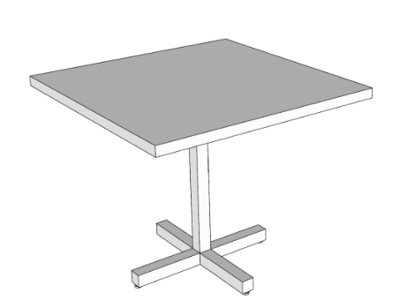
Cafe Table Design A (Pedestal Base, Cross Style, 2”Square Tube w/Levelers)
Square or Round Top
48”W x 29.5”H x 1.25” TH.
30”W x 29.5”H x 1.25” TH.

Slide 5
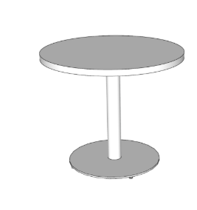
Cafe Table Design B (Pedestal Base, 20” Round Disc (30” top) and 30” Round Disc (48” top)).
Square or Round Top
48”W x 29.5”H x 1.25” TH.
30”W x 29.5”H x 1.25” TH.

Slide 6
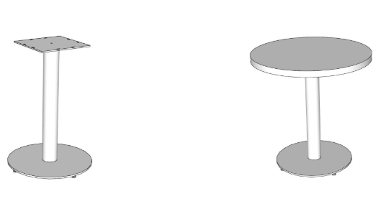
Cafe Table - Bar (Pedestal Base, 20” Round Disc)
Square or Round Top
30”W x 41.5”H x 1.25” TH.

Slide 7
End Table – Square (Laptop Table 1” Square Tube)
18”W x 25.5”H x 1”TH.
16”W x 25.5”H x 1”TH.

Slide 8
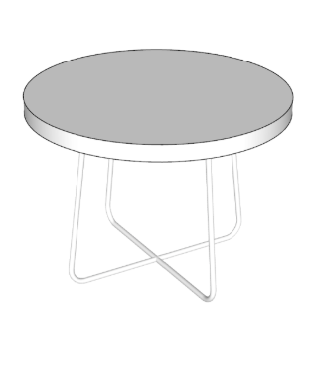
End table – Round (1/2” Rod Cross)
24”W x 17.5”H x 1”TH.
16”W x 17.5”H x 1”TH.

Slide 9
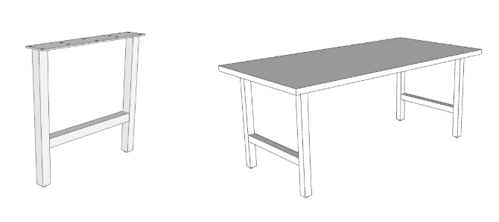
Community Table Design A (H-Leg 2” Square Tube)
Rectangle
36”W x 96”L x 29.5”H x 1.25”TH.
36”W x 76”L x 29.5”H x 1.25”TH.

Slide 10
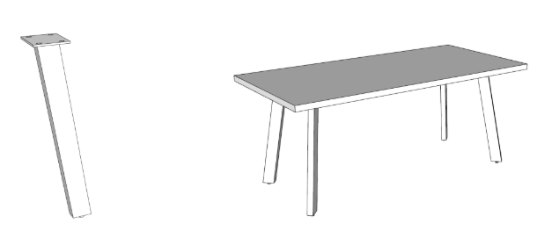
Community Table Design B (Post Leg, 3" x 1.5" Rectangular Tube, angled 10 degrees)
Rectangle
36”W x 96”L x 29.5”H x 1.25”TH.
36”W x 76”L x 29.5”H x 1.25”TH.

Slide 11
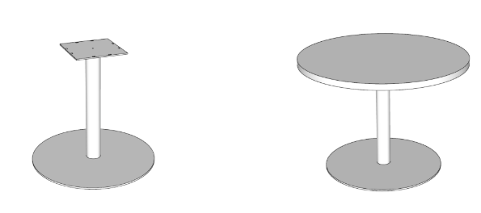
Community Table Design C (Pedestal Base, 30" Round Disc)
Round
54”W x 29.75”H x 1.25”TH.

Slide 12
Coffee Table Design A (1/2" Rod Base)
Round
40” W x 17.5”H x 1.25”TH.
32” W x 17.5”H x 1.25”TH.
24” W x 17.5”H x 1”TH.
16” W x 17.5”H x 1”TH.

Slide 13
Coffee Table Design B (Y-Base, 3" Flat Stock, angled 10 degrees)
Round
40” W x 17.5”H x 1.25”TH.
32” W x 17.5”H x 1.25”TH.
24” W x 17.5”H x 1”TH.
16” W x 17.5”H x 1”TH.

